Slide 1


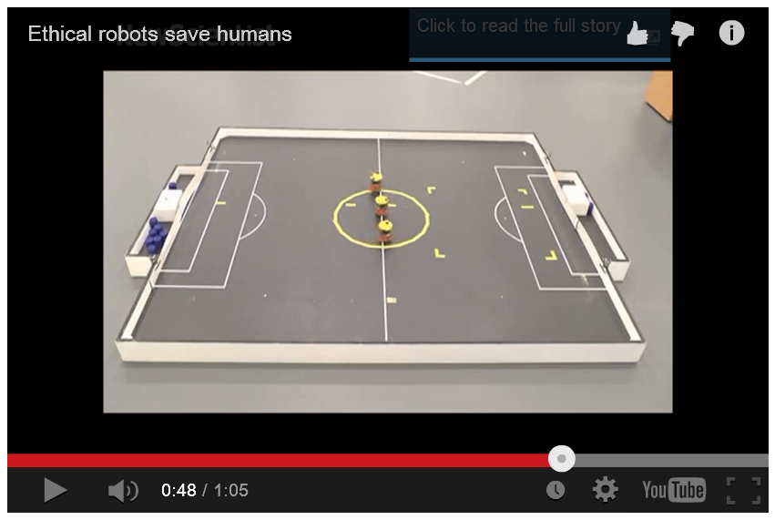
The Beauty and Joy of Computing Lecture #6 Algorithms I
Jon Kotker
UC Berkeley EECS 2010, 2013
(jkotker@berkeley.edu) Microsoft
http://www.newscientist.com/article/mg22329863.700#.VCBKo6x0z6E
Notes:
Alan Winfield of Bristol Robotics Laboratory built an experiment where a robot had to save another robot (a proxy for a human) from falling into a hole.
Became more interesting when there were two robots to save: robot sometimes saved one, sometimes even saved both; 14 out of 33 times though, it had decision paralysis.
Robot is an ‘ethical zombie’: follows instructions but does not know why (or the ethics behind it).
Imbuing a robot with ethics is a hard problem: important especially with the advent of self-driving cars.
Algorithms for military combat robots could be a good starting point – there, robots have an ‘ethical governor’ (a set of algorithms) that helps them make smart decisions in the battlefield. Drones with this programming have been shown to not shoot (or to reduce casualties) in areas protected from combat (like schools and hospitals).
Bottom line: We need to know what assumptions we are making when designing the algorithms – the military robots are one field of application where the rules are ‘known’ so it is relatively straightforward to make ‘ethical algorithms’ for them. The interesting part is in trying to get robots to behave well in circumstances that neither it nor we have encountered.

Slide 2
What is an algorithm?
An algorithm is any well-defined computational procedure that takes some value or set of values as input and produces some value or set of values as output.
The concept of algorithms, however, is far older than computers.
Notes:
Computers are only 50 to 60 years old. Algorithms have been around for thousands and thousands of years. The word itself was seen (in its current form) in the 1690s, though in other variants since the 13th century.

Slide 3

Early Algorithms
Dances, ceremonies, recipes, and building instructions are all conceptually similar to algorithms.
Babylonians defined some fundamental mathematical procedures ~3,600 years ago.
Genes contain algorithms!
Photo credit: Daniel Niles
Notes:
Techniques to make a basket, for a ritual ceremony, for the Macarena!
Multiplication in elementary school.
Babylonians had algorithms to find square roots and to do factorization.
Euclid’s algorithm to find the GCD of two numbers is considered to be the oldest algorithm still used today (300 BC).
Genes encode proteins: there are start and stop locations (“codons”); there are step-by-step processes to transcribe these genes and produce proteins; these proteins fold and interact with each other, and the environment, in particular ways – these result in life and living processes.

Slide 4
Algorithms You've Seen in CS10
Length of word
Whether a word appears in a list
Interact with the user (ask)
Word Comparisons (You wrote one for HW1!)
Sort a List (see lab!)
Make this a block!
Notes:
Length of a word: What if you didn’t have a block for that?
Whether a word appears in a list: ‘Contains’ block, but you could write one yourself.
Interact with the user: Input/output (I/O) technique.
Word comparisons: Comparing a secret word with a guessed word.
Make this a block: Wrap things in functions.
Don’t forget: Clicking something triggers an algorithm…

Slide 5
Algorithms You Might Have Heard Of
Luhn algorithm Credit card number validation | Deflate Lossless data compression
PageRank Google’s way of measuring “reputation” of web pages | EdgeRank Facebook’s method (ca. 2010) for determining what is highest up on your news feed
Notes:
Lunh algorithm: used to determine if a particular number is a possibly valid number. It adds a ‘checksum’ digit (a redundant digit) that is appended to the number; if the checksum does not correspond to the rest of the number, then the number is incorrect.
“Lossless” = reversible.
EdgeRank algorithm, which used three different factors, has given way to an algorithm that reportedly uses more than 100,000 factors (but is proprietary).

Slide 6
Announcements: Quest
Wednesday, October 1.
Short exam in class.
Questions are mostly multiple-choice, circle the correct answer, indicate what happens, predict the output, and so on.
Quest is a sanity check – if you have been showing up to lectures, labs and discussions, and you understand the overall concepts, you should be fine. If you do not understand something, please ask for help. The staff is always willing to help. ☺
Notes:
Quest:
In nine days, on Wednesday, October 1. Short exam in class.
No actual programming questions, since there is no way yet to transcribe blocks into text.
Questions are mostly multiple-choice, circle the correct answer, indicate what happens, predict the output, …
Quest is a sanity check – if you’ve been coming to lectures, labs and discussions, you should be fine.

Slide 7
Important Terms
Sequencing Application of each step of an algorithm in order (sometimes: find order) | Selection Use of Boolean condition to select execution parts
Iteration Repetition of part of an algorithm until a condition is met | Recursion Repeated application of the same part of algorithm on smaller problems
Notes:
Sequencing: When you saw your first program, which blocks go before which? Which steps happen before which steps?
Selection: Which part of the code gets executed based on a condition? Forks in a road? If/else?
Iteration: Do something over and over until a condition is met.
Recursion: You’ll see this again later in much more detail. To define something, you use itself on smaller inputs.
(Example: Eating chocolate.)

Slide 8
Properties of Algorithms
Algorithm + Algorithm = Algorithm
Part of Algorithm = Algorithm
Algorithms can be efficient or inefficient given a comparison algorithm
Several algorithms may solve the same problem
Notes:
Putting together two algorithms to complete two tasks produces an algorithm that now completes both of those tasks.
Smaller part of algorithm that does a certain task is also an algorithm that now does a sub-part of a bigger task.
There are many ways to do something – example: sorting a list using quicksort or insertion sort or Bogosort; adding two numbers together.

Slide 9
Algorithm Correctness
TOTAL Correctness Always reports, and the answer is always correct.
PARTIAL Correctness Sometimes reports, and the answer is always correct when it reports.
We don't only want algorithms to be fast and efficient; we also want them to be correct!
We also have probabilistic algorithms that have a certain probability of returning the right answer.
Notes:
Algorithms should be correct – this is more important than being fast and efficient. In this class, we will not be too concerned with the efficiency of your algorithm, so long as it is always correct. We might ask you how efficient your algorithm is.
TOTAL Correctness: Always returns a value. This is the best scenario for an algorithm (and if it is the most efficient, even better).
Examples: Luhn Algorithm, Mathematical Calculations, Encryption and Decryption
PARTIAL Correctness: Perfect Numbers (28 is one), the “halting problem”, the “is there a bug in my program?” problem
PROBABALISTIC: Getting the exact answer takes a really long time: Traveling Salesman Problem; weather predictions; file download times; existence of a number in a huge, huge list (or the mean); problems where even your input is probabilistic (search queries).

Slide 10
How to Express Algorithms…
A programmer’s spouse tells him: “Run to the store and pick up a loaf of bread. If they have eggs, get a dozen.” The programmer comes home with 12 loaves of bread.
Algorithms need to be expressed in a context-free, unambiguous way for all participants.
Notes:
“Lather, rinse, repeat” joke.
We have yet to reach the goal of programming a robot by speaking to it. NLP (natural language processing) is a hard field because of all the ambiguities in language that computers have yet to be able to understand very well. Context is also very important in natural language (big deal when Google and Bing came out with contextual search.)
Need to know and state all of your assumptions – Sorting a list: what if the list has words and numbers? Adding two numbers: what if one of them is negative?
In the case of the robot with the ethical dilemma, unambiguity is tricky because we may not know of all the possible inputs or contexts. That’s why the output might not always be what you expect – this is another example of a probabilistic algorithm.
You truly understand an algorithm when you are able to program a computer to do it – a computer merely follows instructions. The computer is never wrong; the output might not be what you expect, but that’s only because you provided an incorrect or an incomplete program to the computer.

Slide 11
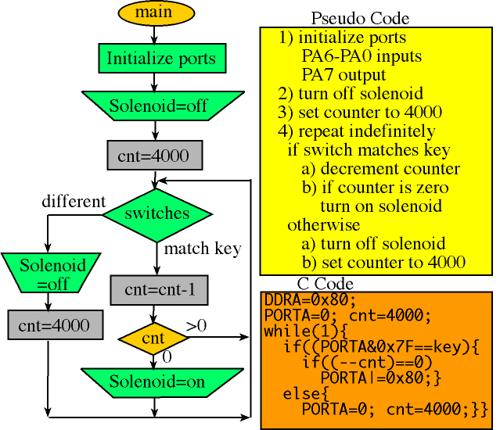
Ways to Express Algorithms
Natural Language
Pseudo Code
Programming Language
…or in any other
information conveying way!
Notes:
Image represents the different ways of specifying an algorithm to do something.
Natural Language: Describe your algorithm to me in a way that I can understand and implement it. In fact, one way of refining your algorithm is to talk it out with someone -- through talking, you get to understand the assumptions that you are making that the other person may not make; through talking, you might also stumble through the answer because you are able to tease apart your thoughts. Also, ‘rubber duck debugging’.
Pseudo Code: Semi-English; mixed between English and programming language; “code” that is similar to what you might write or drag in your program, but not bound by any language or any syntax is particular. Uses constructs common across languages, such as if-conditionals, while-loops. Can sweep entire assumptions under the rug: “Find the length of a word.”
Flowchart: Pictoral representation of an algorithm – squares represent statements; diamonds represent decision points.
Programming Language: How you would finally implement an algorithm on a computer.
Block diagrams: Yet another way.
Move from natural language to pseudo-code to programming language.

Slide 12
Programming Languages
C/C++ Good for programming that is close to hardware | Java/C# Portable code
Python/Perl/TclTK Fast to write and portable | BASIC/BYOB/SNAP Good for teaching programming concepts
All programming languages can be used to implement (almost) any algorithm!
Notes:
Talk about programming languages and history: The slide approximately corresponds to the progression of languages.
You may have heard of many of these programming languages, and there are so many more; utility of a programming language depends on what you need to accomplish.
C/C++: Lower-level languages; talk directly to the hardware; dependent on the hardware that you are working with.
Java/C#: Portable code that runs independently of the hardware – higher level than C/C++.
Python/Perl/TclTK: Write scripts (or “throwaway code”) to do something quickly – search through files in a filesystem; move files around; ping another computer to get the temperature elsewhere; quick data munging (data cleanup).
BASIC/BYOB/SNAP: Great for getting started learning different concepts; might not be great for large (million-line) projects that need to be maintained for longer periods (PowerPoint in SNAP?!). Also, harder to search through.
From the ‘Programming Paradigms’ lecture, we know that all of the well-known (and frequently used) programming languages are equally powerful (and can implement multiple programming paradigms!), so we can use any of them to implement an algorithm.

Slide 13
Choosing a Technique
Most problems can be solved in more than one way, i.e., multiple algorithms exist to describe how to find the solution.
The right language makes formulating algorithms easier and clearer.
Not all of these algorithms are created equal. Very often we have to make some trade-offs when we select a particular one.
There are unsolvable problems!
Notes:
Though we can implement an algorithm in any language, the right language can make it easier to implement – (efficient) sorting can be complicated, but if we have languages and libraries that abstract that away from us, we would prefer that, so that we can focus on other things. (Python and Java, for example, have Timsort, invented by Tim Peters – quicker than quick-sort on real-world data).
Efficiency of an algorithm is something that will covered in more detail during the next lecture: You will learn a common language to communicate with other computer scientists about the efficiency of an algorithm. As a first-pass, what are some things you might be concerned about, if you were trying to choose between different algorithms? What are some trade-offs you would possibly need to account for?
Unsolvable problems: (a) Problems for which there are no solutions in the search space; (b) Problems for which there can never be a solution (halting problem); (c) Problems for which the answer would take a very long time (or space) to find – the game of chess has 10¹²³ possible legal games, so much more than the number of atoms in the observable Universe (10⁸¹).

Slide 14

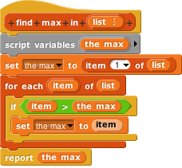
Algorithms vs. Functions and Procedures
Algorithms are conceptual definitions of how to accomplish a task and are language agnostic, usually written in pseudo-code.
Find max value in list
Set (a temporary variable) the max as the first element
Go through every element, compare to max, and if it’s bigger, replace the max
Return the max
A function or procedure is an implementation of an algorithm, in a particular language.
Find max value in list
Notes:
Church-Turing thesis: If you can come up with an algorithm, there is a corresponding function that implements it (and vice-versa).
‘Function’ is the pure definition of a function (no state, no side effects) – it always returns a value.
‘Procedure’ is a block, like a function, but may have a state or side effects – it also does not need to return a value.
===========
POINT OUT YOU CANNOT DRAG VARIABLES IN A SET BLOCK

Slide 15
Summary
The concept of an algorithm has been around forever, and is an integral topic in CS.
Algorithms are well-defined procedures that can take inputs and produce output. Programming languages help us express them.
We're constantly dealing with trade-offs when selecting / building algorithms.
Correctness is particularly important and testing is the most practical strategy to ensure it.
Many write tests first!
Notes:
Test-driven development!
Write tests that execute different paths in your program.
IF TIME GO BACK TO THE LAB EXAMPLE.

